Slide 1
Database Design and Development
数据库设计与开发
Xiaolin Zhao

Slide 2
Chapter 1:
The Worlds of Database Systems

Slide 3
Outline
Why do we need a DBMS (Database Management System)?
What can a DBMS do for an application?
Why study database systems?
Data Models: Overview of a Relational Model
Levels of Abstraction (抽象层次) in a DBMS
Sample Queries（查询） in DBMS
Transaction Management （处理管理）Overview
Structure of a DBMS

Slide 4
What can DBMS do for applications?
Store huge amount of data (e.g.,TB+) over a long period of time
Allow apps to query and update data
Query: what is Mary’s grade in the “Operating System” course?
Update: enroll Mary in the “Database” course
Protect from unauthorized（没授权的） access（访问）
Students cannot change their course grades.
Protect from system crashes
When some system components fail (hard drive, network, etc.),
database can be restored to a good state.

Slide 5
More on what can DBMS do for applications?
Protect from incorrect inputs
Mary has registered for 100 courses
Support concurrent（并发） access from multiple users
1000 students using the registration system at the same time
Allow administrators to easily change data schema（架构）
At a later time, add TA info to courses.
Efficient （高效）database operations
Search for students with 5 highest GPAs

Slide 6
Alternative（替代方案） to Using a DBMS
Store data as files in operating systems.
Applications have to deal with the following issues:
32-bit addressing (4GB) （寻址）is insufficient （不够）to address
100GB+ data file
Write special code to support different queries
Write special code to protect data from concurrent access
Write special code to protect against system crashes
Optimize （优化）applications for efficient （高效）access and query
May often rewrite applications
Easier to buy a DBMS to handle these issues

Slide 7
Database Management System (DBMS)
DBMS is software to store and manage data, so applications don’t have to worry about them.
What can a DBMS do for applications?
– Can you think of them?

Slide 8
What can a DBMS do for applications?
Define data: Data Definition Language (DDL)
Access and operate on data: Data Manipulation Language (DML)（数据操作语言）
Query language
Storage management
Transaction Management（事务管理）
Concurrency control
Crash recovery（故障恢复）
Provide good security,
efficiency, and scalability（可拓展性）
Applications
System (DBMS)
Abstraction & Interface (Database language: SQL)
Perform dirty work that you don’t want applications to do

Slide 9
Why Study Database Systems?
They are everywhere.
Online stores, real stores
Banks, credit card companies
Passport control
Police (criminal records)
Airlines and hotels (reservations)
DBMS vendors（供应商） & products
Oracle, Microsoft (Access and SQL server), IBM (DB2), Sybase, …

Slide 10
Data Models
A data model is a collection of concepts（概念） for describing data.
Entity-relation (ER) model
Relational model (main focus of this course)
A schema is a description of data.
The relational model is the m ost widely used data model.
A relation is basically a table with rows and columns of records.
Every relation has a schema, which describes the columns, or fields.

Slide 11
Relational Model
The entire table shows an instance（实例） of the Students relation.
The Students schema is the column heads （列标题）
– Students(Sid: String, Name: String, Login: String, age: Integer,… )
sid | name | email | age | gpa
53666 | Jones | Jones@cs | 18 | 3.4
53688 | Smith | Smith@ee | 18 | 3.2
53650 | Joe | Joe@cs | 19 | 2.5

Slide 12
Levels of Abstractions in DBMS
Many views, one conceptual schema and one physical schema.
Conceptual schema defines logical structure逻辑结构
Relation tables
Physical schema describes the
file and indexing used
Sorted file with B+ tree index
Views describe how applications (users) see the data
Relation tables but not store explicitly
App1
App2
View 1
View 2
View 3
Conceptual Schema概念模式
Physical Schema物理模式

Slide 13
Example: University Database
Conceptual schema:
Students (sid: string, name: string, login: string, age: integer, gpa:real)
Courses (cid: string, cname:string, credits:integer)
Enrolled (sid:string, cid:string, grade:string)
Physical schema:
Relations stored as unordered files（无序文件）.
Index on first column of Students.
View (External Schema):
Course_info(cid:string, enrollment:integer)
Why?

Slide 14
Data Independence数据独立性
Three levels of abstraction provides data independence.
Changes in one layer only affect one upper layer.只影响上面层
E.g., applications are not affected by changes in conceptual & physical schema.
App1
App2
View 1
View 2
View 3
Conceptual Schema
Physical Schema

Slide 15
Queries in DBMS
Sample queries on university database:
What is the name of the student with student ID 123456?
The key benefits of using a relational database are
Easy to specify queries using a query language: Structured Query Language (SQL)
SELECT S.name FROM Students S
WHERE S.sid = 123456
Efficient query processor to get answer
16

Slide 16
Transaction Management事务处理
A transaction is an execution执行 of a user program in a DBMS.
Transaction management deals with two things:
Concurrent execution of transactions并发控制
Incomplete transactions and system crashes

Slide 17
Concurrency Control
Example: two travel agents旅行社(A, B) are trying to book one remaining airline seat (two transactions), only one transaction can succeed in booking.
// num_seats is 1
Transactions A and B: if num_seats > 0, book the seat & num_seat--;
// overbook!
How to solve this?

Slide 18
Concurrency Control (Solution)
// num_seats is 1
Transactions A and B: if num_seats > 0, book the seat & num_seat--;
// overbook!
Solution: use locking protocol锁协议
Transaction A: get exclusive lock独占锁on num_seats Transaction B: wait until A releases lock on num_seats
Transaction A: if num_seats > 0, book & num_seat--;
// book the seat, num_seat is
set to 0
Transaction A: release exclusive lock on num_seats
Transaction B: num_seats = 0, no booking; // does not book the
seat

Slide 19
Crash Recovery
Example: a bank transaction transfers交易转账
$100 from account A to account B
A = A - $100
// good for the bank!
<system crashes> B = B + $100
How to solve this?

Slide 20
Crash Recovery (Solution)
A = A - $100
<system crashes> // good for the bank!
B = B + $100
Solution: use logging, meaning that all write operations are recorded in a log on a stable storage.
A = A - $100 // recorded A value (checkpoint) in a log
<system crashes>
// start recovery: read the log from disk
//analyze, undo, & redo

Slide 21
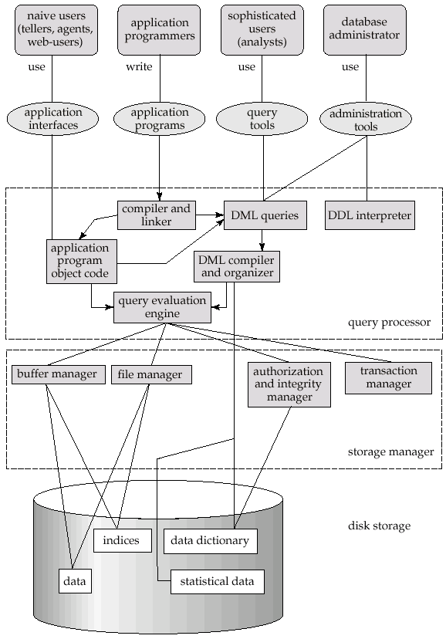
Overview of DBMS

Slide 22
Layered Architecture分层架构
Applications
Queries
Query Optimization 优化 and Execution执行
Relational Operators关系运算符
Files and Access Methods文件和访问方法
Buffer Management缓冲区管理
Disk Space Management
These layers must consider concurrency control and crash recovery

Slide 23
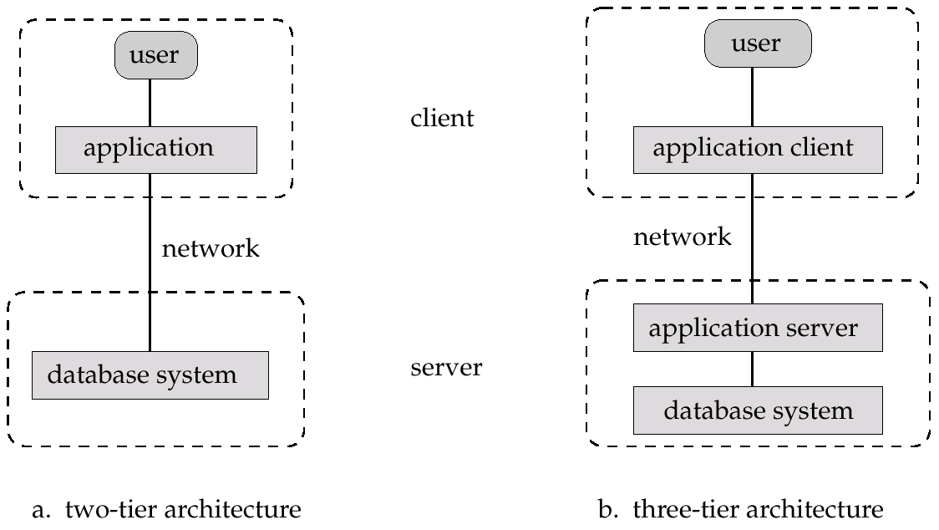
Application Architectures
Two-tier双层 architecture:E.g. client programs using ODBC以目标为导向的数据库/JDBC（JAVA数据库连接） to communicate with a database
Three-tier architecture: E.g. web-based applications, and
applications built using “middleware”

